Slide 1

Final Project Status Report 1
William Yang

Slide 2
Work Accomplished
Obtained dataset
Cleaned dataset
Filtered out / replaced null values
Removed rows / columns that didn’t make sense
Log / winsorized columns with many outliers
Performed EDA on dataset

Slide 3
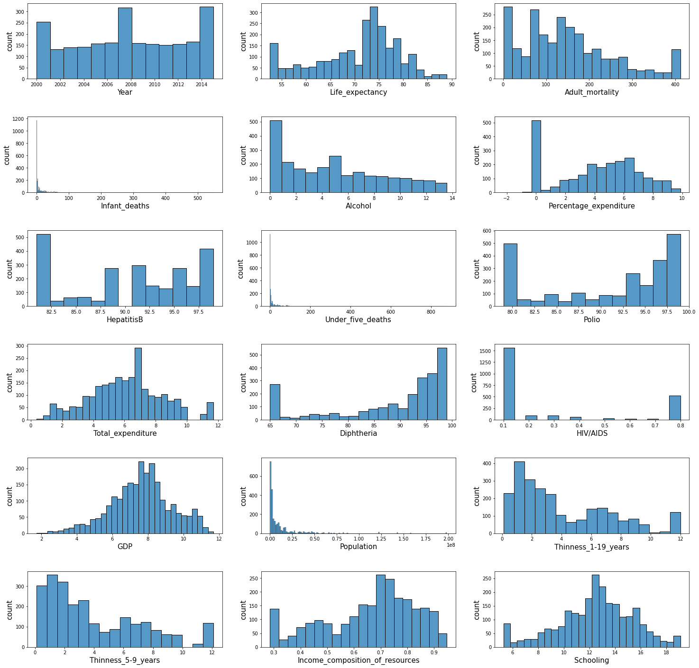
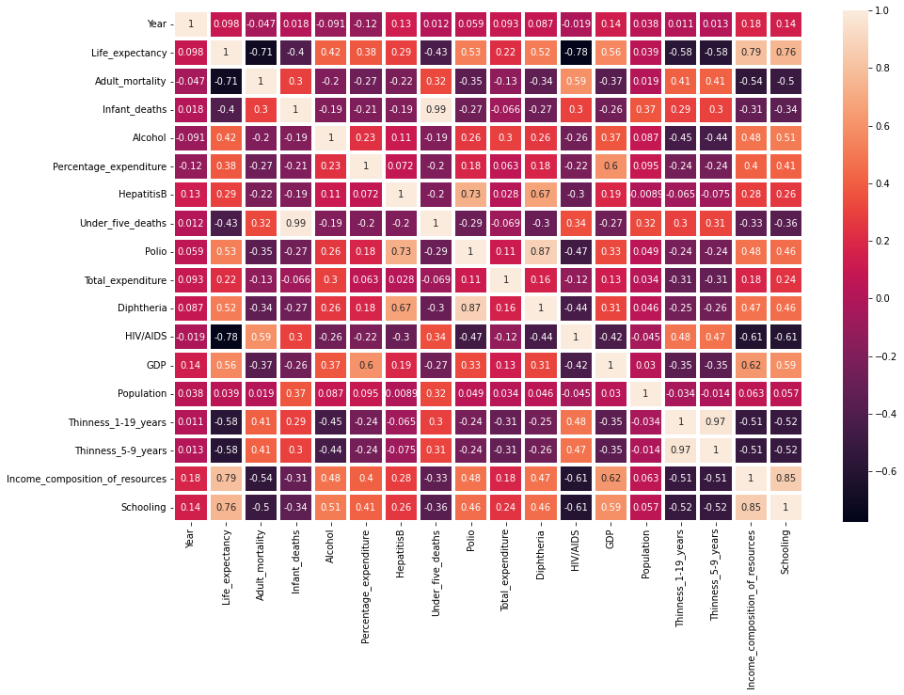
Results
Features with positive correlation with life expectancy:
Polio, Diptheria, GDP, Income Composition of Resources, Schooling
Features with negative correlation with life expectancy:
Adult Mortality, HIV/AIDS, Thinness 1-19 Years, Thinness 5-9 Years
Full process and results can be viewed here:
https://github.com/billbo-yang/DS503_Final_Project/blob/main/eda.ipynb

Slide 4
Plans for Next week
Choose machine learning model to use on dataset
Debating between the following:
Linear regression
Random forest regression
Might potentially move forward with both and then use the one with better performance for the final deliverable
Train machine learning model on dataset
Evaluate performance of machine learning model

Slide 5
Obstacles / Improvements
The dataset used has a lot of issues with it
Lots of the data seems to be incorrect / need cleaning
Columns like BMI had some outrageous values (average BMI of >40!) and had to be removed
Some rows had outrageous values for columns like Infant deaths, Measles, and Under Five Deaths
Lots of outliers for all columns, needed to be winsorized
These problems have been mitigated, as mentioned above
However, calls into question the effectiveness of the machine learning model
If the data is inaccurate, the model will be too

